Slide 1
Dissimilarity Computation and Data Preprocessing
P. Krishna Reddy
IIIT Hyderabad

Slide 2

Lecture #4

Slide 3
Detailed Syllabus
Introduction (1.5 hour): Definition, KDD framework, Issues in data mining.
Data summarization (7.5 hrs): Data Types, Preprocessing, Characterization, Discrimination, data warehousing techniques (Multidimensional data model, Data warehousing architecture, Data cube computation and OLAP technology)
Concepts and algorithms for mining patterns and associations (9 hours) (Frequent item-set generation, A priori and FP-growth algorithm, Evaluation of Association patterns) and preprocessing
Concepts and algorithms related to classification and regression (9hrs) (Overview, Decision tree induction, Over-fitting and under-fitting, Scalable decision tree algorithms, Bayesian Classification, Regression-based Prediction methods (9 hours)
Concepts and algorithms for clustering the data (9 hours) (Overview, Types of Data, K-means, Aglomerative clustering, Clustering algorithms (DBSCAN, BIRCH, CURE, ROCK, CHAMELEON)).
Outlier analysis and future trends (graph mining, spatio-temporal mining). (3 hours)

Slide 4
Outline
Proximity computation measures

Slide 5
Proximity: Similarity or Dissimilarity
So far we have analyzed the values of single attribute
  Central tendency, dispersion, and spread of some attribute X.
Objects are described by multiple attributes.
Similarity
  Numerical measure of how alike two data objects are
    How to compare two persons or two objects?
  Value is higher when objects are more alike
  Often falls in the range [0,1]
Dissimilarity (e.g., distance)
  Numerical measure of how different two data objects are
  Lower when objects are more alike
  Minimum dissimilarity is often 0
  Upper limit varies
Proximity refers to a similarity or dissimilarity

Slide 6
Dissimilarity/Similarity metric
Dissimilarity/Similarity metric
  Similarity is expressed in terms of a distance function, typically metric: d(i, j)
  The definitions of distance functions are usually rather different for interval-scaled, boolean, categorical, ordinal ratio, and vector variables
  Weights should be associated with different variables based on applications and data semantics
sim(i,j)= 1-d(i,j)

Slide 7
Metric
A distance that satisfies the following properties is a metric
  Non-negativity: d(i, j) > 0 if i ≠ j, and d(i, i) = 0 (Positive definiteness)
    Distance is non-negative number
  Identify: d(i,j) >= 0
    The distance of an object to itself is 0
  d(i, j) = d(j, i) (Symmetry)
    Distance is a symmetric function
  d(i, j) ≤ d(i, k) + d(k, j) (Triangle Inequality)

Slide 8


Data Matrix and Dissimilarity Matrix
Data matrix
  n data points with p dimensions
Dissimilarity matrix
  n data points, but registers only the distance
  A triangular matrix
  Single mode
Most clustering and nearest neighbor algorithms operate on dissimilarity matrix

Slide 9
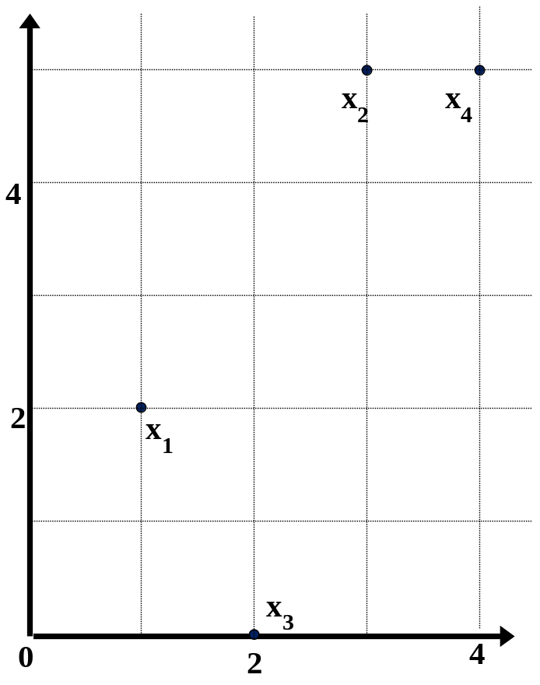
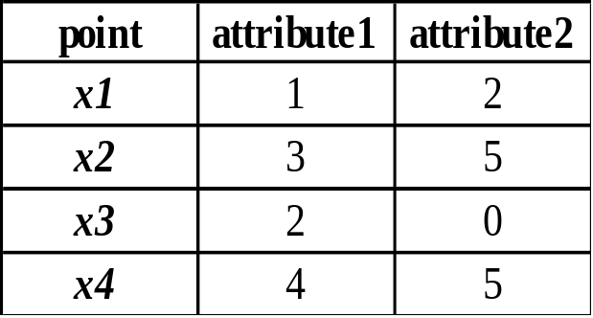
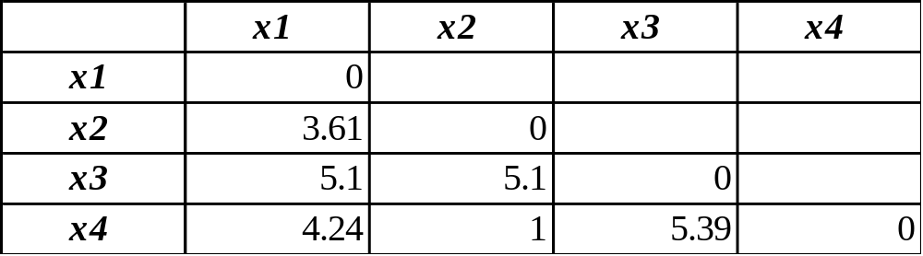
Example:
Data Matrix and Dissimilarity Matrix
Data Matrix
Dissimilarity Matrix
(with Euclidean Distance)

Slide 10
Types of Attributes
Nominal attributes
Binary attributes
Numeric data
Ordinal data
Mixed data

Slide 11

Proximity Measure for Nominal Attributes
Can take 2 or more states
  Example: Map colour (red, yellow, blue, green (generalization of a binary attribute))
Let i and j are objects with p variables
Method 1: Simple matching
  m: # of matches, p: total # of variables
  The dissimilarity
Method 2: Use a large number of binary attributes
  creating a new binary attribute for each of the M nominal states

Slide 12
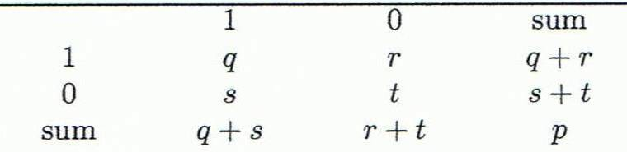
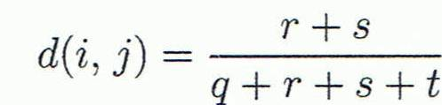
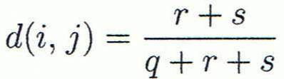

Proximity Measure for Binary Attributes
A contingency table for binary data
  q: # of attributes equal to 1 in i and j.
  r: # of attributes equal to 1 in i but equal to 0 in j
  s :# of attributes equal to 0 in i but equal to 1 in j
  t: # of attributes that equal to 0 for both i and j
Distance measure for symmetric binary variables:
Distance measure for asymmetric binary variables:
Jaccard coefficient (similarity measure for asymmetric binary variables): 1-d(i,j)
Object j
Object i
Note: Jaccard coefficient is the same as “coherence”:

Slide 13
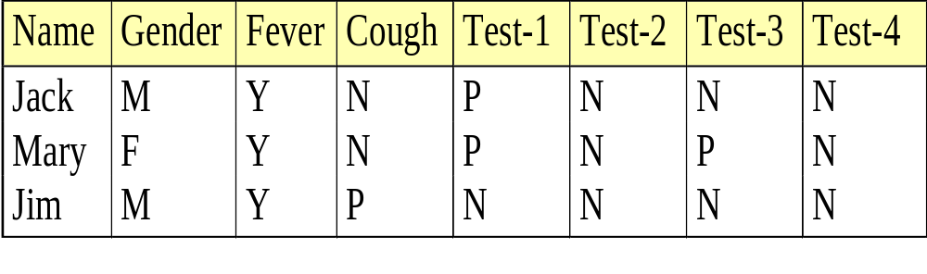

Example: Dissimilarity between
Asymmetric Binary Variables
Mary
 | 1 | 0 | ∑_{row}
1 | 2 | 0 | 2
0 | 1 | 3 | 4
∑_{col} | 3 | 3 | 6
Jack
Gender is a symmetric attribute (not counted in)
The remaining attributes are asymmetric binary
Let the values Y and P be 1, and the value N be 0
Distance:
Jim
 | 1 | 0 | ∑_{row}
1 | 1 | 1 | 2
0 | 1 | 3 | 4
∑_{col} | 2 | 4 | 6
Jack
Mary
 | 1 | 0 | ∑_{row}
1 | 1 | 1 | 2
0 | 2 | 2 | 4
∑_{col} | 3 | 3 | 6
Jim

Slide 14
Distance on Numeric Data: Minkowski Distance
Minkowski distance: A popular distance measure
  where i = (x_{i1}, x_{i2}, …, x_{ip}) and j = (x_{j1}, x_{j2}, …, x_{jp}) are two p-dimensional data objects, and h is the order (the distance so defined is also called L-h norm)

Slide 15


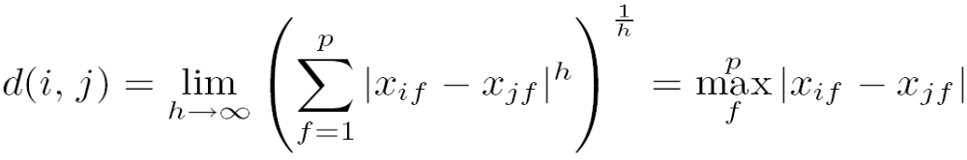
Special Cases of Minkowski Distance
h = 1: Manhattan (city block, L₁ norm) distance
  E.g., the Hamming distance: the number of bits that are different between two binary vectors
h = 2: (L₂ norm) Euclidean distance
h → ∞. “supremum” (L_{max} norm, L∞ norm) distance.
  This is the maximum difference between any component (attribute) of the vectors

Slide 16
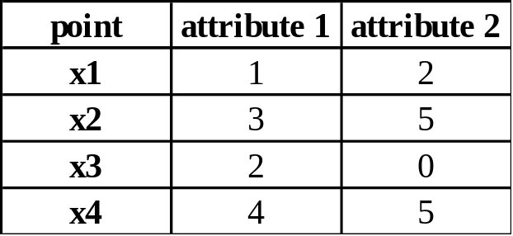
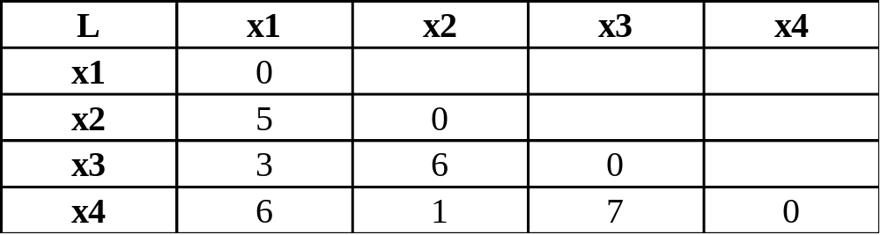
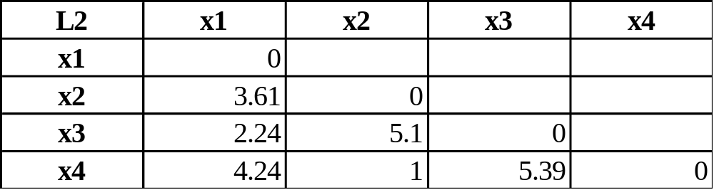
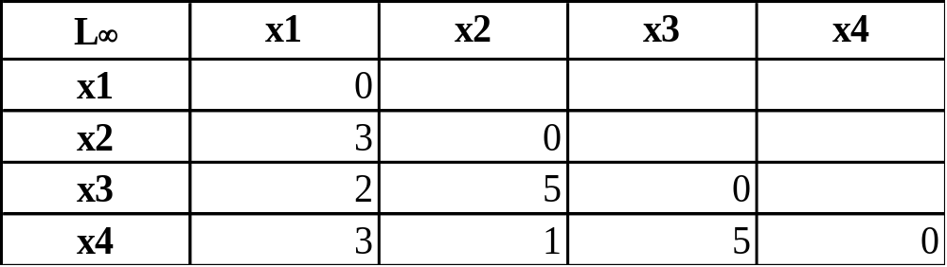
Example: Minkowski Distance
Dissimilarity Matrices
Manhattan (L₁)
Euclidean (L₂)
Supremum

Slide 17
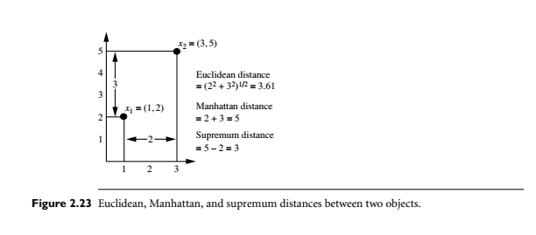

Slide 18
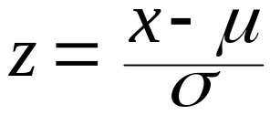
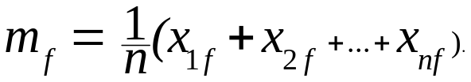
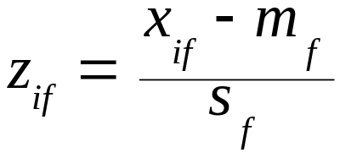
Standardizing Numeric Data
Z-score:
  x: raw score to be standardized, μ: mean of the population, σ: standard deviation
  the distance between the raw score and the population mean in units of the standard deviation
  negative when the raw score is below the mean, “+” when above
An alternative way: Calculate the mean absolute deviation
  where
  standardized measure (z-score):
Using mean absolute deviation is more robust than using standard deviation

Slide 19


Ordinal Variables
An ordinal variable can be discrete or continuous
Order is important, e.g., rank
Can be treated like interval-scaled
  replace x_{if} by their rank
  map the range of each variable onto [0, 1] by replacing i-th object in the f-th variable by
  compute the dissimilarity using methods for interval-scaled variables

Slide 20
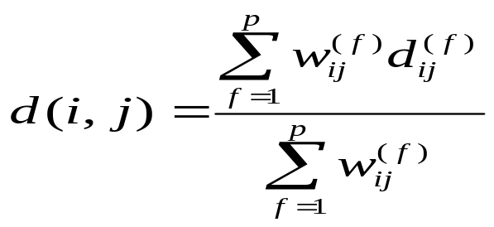
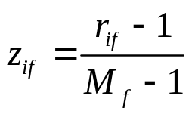
Attributes of Mixed Type
A dataset may contain all attribute types
  Nominal, symmetric binary, asymmetric binary, numeric, and ordinal
One may use a weighted formula to combine their effects:
  If f is numeric: Use the normalized distance
  If f is binary or nominal: d_{ij}^{(f)} = 0 if x_{if} = x_{jf}; or d_{ij}^{(f)} = 1 otherwise
  If f is ordinal
    Compute ranks z_{if} (where )
    Treat z_{if} as interval-scaled

Slide 21
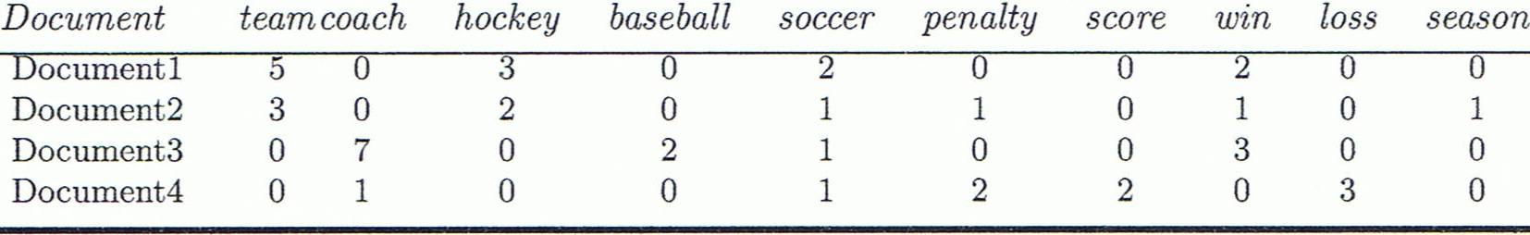
Cosine Similarity
A document can be represented by thousands of attributes, each recording the frequency of a particular word (such as keywords) or phrase in the document.
Other vector objects: gene features in micro-arrays, …
Applications: information retrieval, biologic taxonomy, gene feature mapping, ...
Cosine measure: If d₁ and d₂ are two vectors (e.g., term-frequency vectors), then
cos(d₁, d₂) = (d₁ • d₂) /||d₁|| ||d₂|| ,
  where • indicates vector dot product, ||d||: the length of vector d

Slide 22
Example: Cosine Similarity
cos(d₁, d₂) = (d₁ • d₂) /||d₁|| ||d₂|| ,
  where • indicates vector dot product, ||d|: the length of vector d
Ex: Find the similarity between documents 1 and 2.
  d₁ = (5, 0, 3, 0, 2, 0, 0, 2, 0, 0)
  d₂ = (3, 0, 2, 0, 1, 1, 0, 1, 0, 1)
  d₁•d₂ = 5*3+0*0+3*2+0*0+2*1+0*1+0*1+2*1+0*0+0*1 = 25
  ||d₁||= (5*5+0*0+3*3+0*0+2*2+0*0+0*0+2*2+0*0+0*0)^{0.5}=(42)^{0.5} = 6.481
  ||d₂||= (3*3+0*0+2*2+0*0+1*1+1*1+0*0+1*1+0*0+1*1)^{0.5}=(17)^{0.5} = 4.12
  cos(d₁, d₂ ) = 0.94

Slide 23
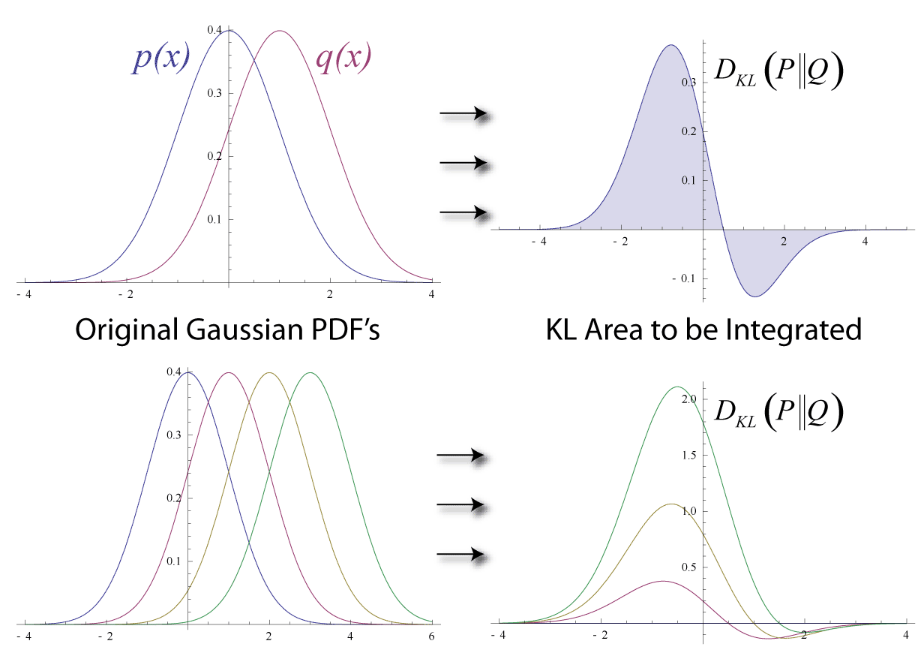
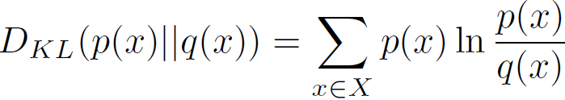
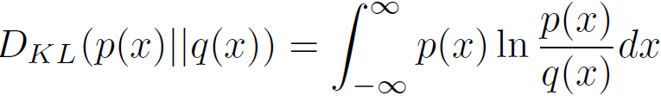
KL Divergence: Comparing Two Probability Distributions
The Kullback-Leibler (KL) divergence: Measure the difference between two probability distributions over the same variable x
  From information theory, closely related to relative entropy, information divergence, and information for discrimination
D_{KL}(p(x) || q(x)): divergence of q(x) from p(x), measuring the information lost when q(x) is used to approximate p(x)
Discrete form
Ack.: Wikipedia entry: The Kullback-Leibler (KL) divergence
Continuous form

Slide 24
More on KL Divergence
The KL divergence measures the expected number of extra bits required to code samples from p(x) (“true” distribution) when using a code based on q(x), which represents a theory, model, description, or approximation of p(x)
The KL divergence is not a distance measure, not a metric: asymmetric, not satisfy triangular inequality (D_{KL}(P‖Q) does not equal D_{KL}(Q‖P))
In applications, P typically represents the "true" distribution of data, observations, or a precisely calculated theoretical distribution, while Q typically represents a theory, model, description, or approximation of P.
The Kullback–Leibler divergence from Q to P, denoted D_{KL}(P‖Q), is a measure of the information gained when one revises one's beliefs from the prior probability distribution Q to the posterior probability distribution P. In other words, it is the amount of information lost when Q is used to approximate P.
The KL divergence is sometimes also called the information gain achieved if P is used instead of Q. It is also called the relative entropy of P with respect to Q.

Slide 25
KDD process
Data preprocessing is a major step
Learning the application domain:
  relevant prior knowledge and goals of application
Creating a target data set: data selection
Preprocessing: (may take 60% of effort!)
Data reduction and transformation:
  Find useful features, dimensionality/variable reduction, invariant representation.
Choosing functions of data mining
  summarization, classification, association, clustering.
Choosing the mining algorithm(s)
Data mining: search for patterns of interest
Pattern evaluation and knowledge presentation
  visualization, transformation, removing redundant patterns, etc.
Use of discovered knowledge

Slide 26
Why Data Preprocessing?
Data in the real world is dirty
  incomplete: lacking attribute values, lacking certain attributes of interest, or containing only aggregate data
    e.g., occupation=“ ”
  noisy: containing errors or outliers
    e.g., Salary=“-10”
  inconsistent: containing discrepancies in codes or names
    e.g., Age=“42” Birthday=“03/07/1997”
    e.g., Was rating “1,2,3”, now rating “A, B, C”
    e.g., discrepancy between duplicate records

Slide 27
Why Is Data Dirty?
Incomplete data may come from
  “Not applicable” data value when collected
  Different considerations between the time when the data was collected and when it is analyzed.
  Human/hardware/software problems
Noisy data (incorrect values) may come from
  Faulty data collection instruments
  Human or computer error at data entry
  Errors in data transmission
Inconsistent data may come from
  Different data sources
  Functional dependency violation (e.g., modify some linked data)
Duplicate records also need data cleaning

Slide 28
Why Is Data Preprocessing Important?
No quality data, no quality mining results!
  Quality decisions must be based on quality data
    e.g., duplicate or missing data may cause incorrect or even misleading statistics.
  Data warehouse needs consistent integration of quality data
Data extraction, cleaning, and transformation comprises the majority of the work of building a data warehouse

Slide 29
Data Preprocessing
Data Preprocessing: An Overview
  Data Quality
  Major tasks in Data Preprocessing
Data Cleaning
Data Integration
Data Transformation
Dimensionality Reduction
Summary

Slide 30
Data Quality: Why Preprocess the Data?
Measures for data quality: A multidimensional view
  Accuracy: correct or wrong, accurate or not
  Completeness: not recorded, unavailable, …
  Consistency: some modified but some not, dangling, …
  Timeliness: timely update?
  Believability: how trustable the data are correct?
  Interpretability: how easily the data can be understood?

Slide 31
Example
Consider AllElectronics company
  You want to analyze <item, price, units_sold>
  Observations
    Do not have values for several attributes
    You want to know whether the item was advertised or not, but you find that it was not recorded
    There are errors, unusual values, data inconsistencies
  It means
    Data is incomplete (lacking required attributes)
    Inaccurate or noisy (containing errors or deviate from the expected values)
    Inconsistent (containing discrepancies in the department codes used to categorize items)
      Age=“42”, Birthday=“03/07/2010”
      Was rating “1, 2, 3”, now rating “A, B, C”
      discrepancy between duplicate records

Slide 32
accuracy, completeness and consistency are common-place properties of real world databases
Reasons
  Inaccuracy
    Data collection instruments may be faulty
    Human or computer errors in data entry
    Users purposefully submit incorrect data intentionally for mandatory fields
      By choosing January 1 by default
    Data transmission errors
    Buffer size limitation
    Naming conventions for data codes and different formats

Slide 33
Reasons for incomplete data
  Attributes of interest may not be available
    They were not considered important at the time of entry.
    Relevant data may not be recorded due to misunderstanding or because of equipment malfunctions
    Data may be deleted
    Missing values of the attributes may not be inferred.
Data quality depends on the intended use of data
  If the 80% of addresses are correct
    It is OK for marketing manager
    But, may not be Ok for sales manager

Slide 34
Timeliness, Believability, Interpretability
Timeliness: Consider a giving monthly bonuses to top sales representatives
  If the data is not updated in a monthly fashion has a negative impact on the data quality
Believability
  How much the data is trused by users
  Several errors many lead to lack of trust
Interpretability
  How easy the data are understood
  For example, the data may use several codes; difficult to interpret.

Slide 35
Data Preprocessing
Data Preprocessing: An Overview
  Data Quality
  Major tasks in Data Preprocessing
Data Cleaning
Data Integration
Data Transformation
Dimensionality Reduction
Summary

Slide 36
Major Tasks in Data Preprocessing
Data cleaning
  Fill in missing values, smooth noisy data, identify or remove outliers, and resolve inconsistencies
  Apply data cleaning techniques
Data integration
  Integration of multiple databases, data cubes, or files
  Examples:
  1. customer identification may be referred as customer-id in one database and cust_id in another database
  2. first name may be Bill on one database and William in another database
  How to create a common database by integrating Facebook and LinkedIn users?

Slide 37
Major Tasks in Data Preprocessing
Data reduction
  Question: Data set is very huge. How to reduce the data set size without jeopardizing the data mining results?
  Dimensionality reduction
    Compressed representation
  Numerosity reduction
    Regression or log-linear models
  Data compression
Data transformation and data discretization
  Better results if the data is transformed, i.e., normalized
  Normalization: Example age and salary: transform all age and salary values between 0 and 1.
  Discretization: mining data at different abstraction levels
  Concept hierarchy generation

Slide 38
Data Preprocessing
Data Preprocessing: An Overview
  Data Quality
  Major tasks in Data Preprocessing
Data Cleaning
Data Integration
Data Transformation
Dimensionality Reduction
Summary

Slide 39
How to Handle Missing Data?
Method 1: Ignore the tuple:
  usually done when class label is missing (when doing classification)—not effective when the % of missing values per attribute varies considerably
Method 2: Fill in the missing value manually: tedious + infeasible?
Method 3: Use a global constant to fill the missing value
  a global constant : e.g., “unknown”, a new class?!
Method 4: fill with the attribute mean/ median/mode
Method 5: fill with the attribute mean/ median/mode belong to the same class: Smarter
Method 6: the most probable value: inference-based such as Bayesian formula or decision tree-
  Popular strategy

Slide 40
How to Handle Noisy Data?
Noise: random error or variance in a measured variable
Incorrect attribute values may be due to
  faulty data collection instruments
  data entry problems
  data transmission problems
  technology limitation
  inconsistency in naming convention
Other data problems which require data cleaning
  duplicate records
  incomplete data
  inconsistent data

Slide 41
How to Handle Noisy Data?
Method 1: Binning: consult neighbourhood
  first sort data and partition into (equal-frequency) bins
  then one can smooth by bin means, smooth by bin median, smooth by bin boundaries, etc.
Method 2: Regression
  smooth by fitting the data into regression functions (will discuss later)
Method 3: Clustering
  detect and remove outliers
Combined computer and human inspection
  detect suspicious values and check by human (e.g., deal with possible outliers)

Slide 42
Simple Discretization Methods: Binning
Equal-width (distance) partitioning
  Divides the range into N intervals of equal size: uniform grid
  if A and B are the lowest and highest values of the attribute, the width of intervals will be: W = (B –A)/N.
  The most straightforward, but outliers may dominate presentation
  Skewed data is not handled well
Equal-depth (frequency) partitioning
  Divides the range into N intervals, each containing approximately same number of samples
  Good data scaling
  Managing categorical attributes can be tricky

Slide 43
Binning Methods for Data Smoothing
Sorted data for price (in dollars): 4, 8, 9, 15, 21, 21, 24, 25, 26, 28, 29, 34
* Partition into equal-frequency (equi-depth) bins:
- Bin 1: 4, 8, 9, 15
- Bin 2: 21, 21, 24, 25
- Bin 3: 26, 28, 29, 34
* Smoothing by bin means:
- Bin 1: 9, 9, 9, 9
- Bin 2: 23, 23, 23, 23
- Bin 3: 29, 29, 29, 29
* Smoothing by bin boundaries:
- Bin 1: 4, 4, 4, 15
- Bin 2: 21, 21, 25, 25
- Bin 3: 26, 26, 26, 34

Slide 44
Regression
y
Y1
Y1’
y = x + 1
X1
x

Slide 45
Cluster Analysis

Slide 46
Lecture #5

Slide 47
Data Cleaning as a Process
Step 1: Data discrepancy detection
Step 2: Data transformation.

Slide 48
Data Cleaning as a Process
Step 1: data discrepancy detection
Reasons
  Poorly designed data entry forms
  Deliberate errors
  Data decay (outdated addresses)
  Inconsistent data codes
  The same attribute may have different names
Use the following techniques
Use metadata (e.g., domain, range, dependency, distribution)
  Use any knowledge you have about the data
    Acceptable values of each attribute, range of attribute
    Write your script
      Identify anomalies and trends using basic statistics
Check Field overloading
    Developers squeeze new attribute definitions to unused portions of already used attributes

Slide 49
Data Cleaning as a Process
Step 1: data discrepancy detection (contd.)
Check the following rules
  Uniqueness rule
    Each value of the attribute is different from other value
  Consecutive rule
    There is no missing value between minimum and maximum
      Example check numbers
  Null rule
    Use of blanks, question marks, special characters or strings
    Example: License number is kept blank by non-drivers
Use commercial tools
  Data scrubbing: use simple domain knowledge (e.g., postal code, spell-check) to detect errors and make corrections
  Data auditing: by analyzing data to discover rules and relationship to detect violators (e.g., correlation and clustering to find outliers)

Slide 50
Data Cleaning as a Process
Step 2: data transformation
Data migration
  Data migration tools: allow transformations to be specified
    Example: replacing gender with sex
  ETL (Extraction/Transformation/Loading) tools: allow users to specify transformations through a graphical user interface
Integration of the two processes (discrepancy detection and transformation)
  Iterative and interactive (e.g., Potter’s Wheels tool )
  https://control.cs.berkeley.edu/abc/
Important aspect
  Update the meta-data whenever you modify data

Slide 51
Data Preprocessing
Data Preprocessing: An Overview
  Data Quality
  Major tasks in Data Preprocessing
Data Cleaning
Data Integration
Data Transformation
Dimensionality Reduction
Summary

Slide 52
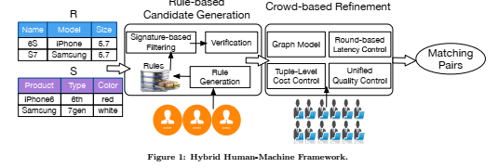
Data Integration
Data integration:
  Combines data from multiple sources into a coherent store
Schema integration: e.g., A.cust-id ≡ B.cust-#
  Integrate metadata from different sources
Sample research paper: Guoliang Li: Human-in-the-loop Data Integration. Proc. VLDB Endow. 10(12): 2006-2017 (2017)

Slide 53
Data Integration: Entity identification problem:
Identify real world entities from multiple data sources,
  e.g., Bill Clinton = William Clinton
Structure of the data
  Functional dependencies and referential integrity constraints should match
  Example: in one data, discount may be on entire order and in another data discount may be on line item
Detecting and resolving data value conflicts
  For the same real world entity, attribute values from different sources are different
  Possible reasons: different representations, different scales, e.g., metric vs. British units

Slide 54
Data integration:
Handling Redundancy in Data Integration
Redundant data occur often when integration of multiple databases
  Object identification: The same attribute or object may have different names in different databases
  Derivable data: One attribute may be a “derived” attribute in another table, e.g., annual revenue
Redundant attributes may be able to be detected by correlation analysis and covariance analysis
Careful integration of the data from multiple sources may help reduce/avoid redundancies and inconsistencies and improve mining speed and quality

Slide 55


Correlation Analysis (Nominal Data)
Suppose A has c distinct values, namely a1,a2,..,ac. B has r distinct values, namely b1,b2,…,br.
The data tuples described by A and B can be shown as a contingency table
Let (Ai,Bj) denote the joint event that attribute A takes on value ai and attribute B takes on value bj, that is, where (A = ai, B = bj).
The χ2 value (also known as the Pearson χ2 statistic) is computed as
Where oij is the observed frequency of the joint event (Ai, Bj) and eij is the expected frequency of the joint event (Ai,Bj)

Slide 56
Correlation Analysis (Nominal Data)
The larger the Χ² value, the more likely the variables are related
The cells that contribute the most to the Χ² value are those whose actual count is very different from the expected count
Correlation does not imply causality
  # of hospitals and # of car-theft in a city are correlated
  Both are causally linked to the third variable: population

Slide 57
Chi-Square Calculation: An Example
Χ² (chi-square) calculation (numbers in parenthesis are expected counts calculated based on the data distribution in the two categories)
It shows that like_science_fiction and play_chess are correlated in the group
 | Play chess | Not play chess | Sum (row)
Like science fiction | 250(90) | 200(360) | 450
Not like science fiction | 50(210) | 1000(840) | 1050
Sum(col.) | 300 | 1200 | 1500

Slide 58
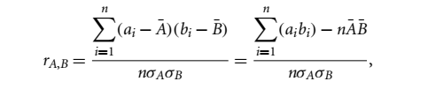


Correlation Analysis (Numeric Data)
Correlation coefficient (also called Pearson’s product moment coefficient)
  where n is the number of tuples, and are the respective means of A and B, σ_{A} and σ_{B} are the respective standard deviation of A and B, and Σ(a_{i}b_{i}) is the sum of the AB cross-product.
If r_{A,B} > 0, A and B are positively correlated (A’s values increase as B’s). The higher, the stronger correlation.
r_{A,B} = 0: independent; r_{AB} < 0: negatively correlated

Slide 59

Visually Evaluating Correlation
Scatter plots showing the similarity from –1 to 1.

Slide 60



Covariance (Numeric Data)
Covariance is similar to correlation
  where n is the number of tuples, and are the respective mean or expected values of A and B, σ_{A} and σ_{B} are the respective standard deviation of A and B.
Positive covariance: If Cov_{A,B} > 0, then A and B both tend to be larger than their expected values.
Negative covariance: If Cov_{A,B} < 0 then if A is larger than its expected value, B is likely to be smaller than its expected value.
Independence: Cov_{A,B} = 0 but the converse is not true:
  Some pairs of random variables may have a covariance of 0 but are not independent. Only under some additional assumptions (e.g., the data follow multivariate normal distributions) does a covariance of 0 imply independence
Correlation coefficient:

Slide 61

Co-Variance: An Example
It can be simplified in computation as
Suppose two stocks A and B have the following values in one week: (2, 5), (3, 8), (5, 10), (4, 11), (6, 14).
Question: If the stocks are affected by the same industry trends, will their prices rise or fall together?
  E(A) = (2 + 3 + 5 + 4 + 6)/ 5 = 20/5 = 4
  E(B) = (5 + 8 + 10 + 11 + 14) /5 = 48/5 = 9.6
  Cov(A,B) = (2×5+3×8+5×10+4×11+6×14)/5 − 4 × 9.6 = 4
Thus, A and B rise together since Cov(A, B) > 0.

Slide 62
Data Integration: Tuple duplication
Duplication should also be detected at tuple level
  Denormalized tables
  Same purchaser name is appearing in different addresses

Slide 63
Data Preprocessing
Data Preprocessing: An Overview
  Data Quality
  Major tasks in Data Preprocessing
Data Cleaning
Data Integration
Data Transformation
Dimensionality Reduction
Summary

Slide 64
Data Transformation
In data transformation, the data are transformed or consolidated into forms appropriate for mining.
Through appropriate data transformation, the resulting mining process may be more efficient, and the patterns found may be easier to understand.
Approaches
  Normalization
  Discretization
  Data compression
  Sampling

Slide 65
Normalization
The measurement unit used can affect the data analysis.
  For example, changing measurement units from meters to inches for height or from kilograms to pounds for weight may lead to very different results.
  Salary attribute may dominate over age attribute
To help avoid dependence on the choice of measurement units, the data should be normalized or standardized.
Normalizing the data attempts to give all attributes an equal weight.

Slide 66





Normalization
Min-max normalization: to [new_min_{A}, new_max_{A}]
  Ex. Let income range $12,000 to $98,000 normalized to [0.0, 1.0]. Then $73,000 is mapped to
Z-score normalization (μ: mean, σ: standard deviation):
  Ex. Let μ = 54,000, σ = 16,000. Then
Normalization by decimal scaling
Where j is the smallest integer such that Max(|ν’|) < 1

Slide 67
Discretization
Data discretization is a common data transformation technique where the raw values of a numeric attribute (e.g., age) are replaced by interval labels (e.g., 0–10, 11–20, etc.) or conceptual labels (e.g., youth, adult, senior).
  The labels, in turn, can be recursively organized into higher-level concepts, resulting in a concept hierarchy for the numeric attribute.

Slide 68
Discretization
Three types of attributes
  Nominal—values from an unordered set, e.g., color, profession
  Ordinal—values from an ordered set, e.g., military or academic rank
  Numeric—real numbers, e.g., integer or real numbers
Discretization: Divide the range of a continuous attribute into intervals
  Interval labels can then be used to replace actual data values
  Reduce data size by discretization
  Supervised vs. unsupervised
  Split (top-down) vs. merge (bottom-up)
  Discretization can be performed recursively on an attribute
  Prepare for further analysis, e.g., classification

Slide 69
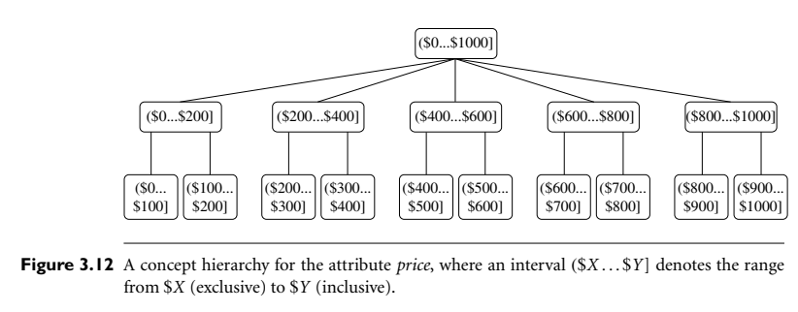

Slide 70
Data Discretization Methods
Typical methods: All the methods can be applied recursively
  Binning
    Top-down split, unsupervised
  Histogram analysis
    Top-down split, unsupervised
  Clustering analysis (unsupervised, top-down split or bottom-up merge)
  Decision-tree analysis (supervised, top-down split)
  Correlation (e.g., χ²) analysis (unsupervised, bottom-up merge)

Slide 71
Simple Discretization: Binning
Equal-width (distance) partitioning
  Divides the range into N intervals of equal size: uniform grid
  if A and B are the lowest and highest values of the attribute, the width of intervals will be: W = (B –A)/N.
  The most straightforward, but outliers may dominate the presentation
  Skewed data is not handled well
Equal-depth (frequency) partitioning
  Divide the range into N intervals, each containing approximately same number of samples
  Good data scaling
  Managing categorical attributes can be tricky

Slide 72
Binning Methods for Data Smoothing
Sorted data for price (in dollars): 4, 8, 9, 15, 21, 21, 24, 25, 26, 28, 29, 34
* Partition into equal-frequency (equi-depth) bins:
- Bin 1: 4, 8, 9, 15
- Bin 2: 21, 21, 24, 25
- Bin 3: 26, 28, 29, 34
* Smoothing by bin means:
- Bin 1: 9, 9, 9, 9
- Bin 2: 23, 23, 23, 23
- Bin 3: 29, 29, 29, 29
* Smoothing by bin boundaries:
- Bin 1: 4, 4, 4, 15
- Bin 2: 21, 21, 25, 25
- Bin 3: 26, 26, 26, 34

Slide 73




Discretization Without Using Class Labels
(Binning vs. Clustering)
Data
Equal interval width (binning)
Equal frequency (binning)
K-means clustering leads to better results

Slide 74
Discretization by Classification & Correlation Analysis
Classification (e.g., decision tree analysis)
  Supervised: Given class labels, e.g., cancerous vs. benign
  Using entropy to determine split point (discretization point)
  Top-down, recursive split
  Details to be covered in Chapter 7
Correlation analysis (e.g., Chi-merge: χ²-based discretization)
  Supervised: use class information
  Bottom-up merge: find the best neighboring intervals (those having similar distributions of classes, i.e., low χ² values) to merge
  Merge performed recursively, until a predefined stopping condition

Slide 75
Concept Hierarchy Generation
Concept hierarchy organizes concepts (i.e., attribute values) hierarchically and is usually associated with each dimension in a data warehouse
Concept hierarchies facilitate drilling and rolling in data warehouses to view data in multiple granularity
Concept hierarchy formation: Recursively reduce the data by collecting and replacing low level concepts (such as numeric values for age) by higher level concepts (such as youth, adult, or senior)
Concept hierarchies can be explicitly specified by domain experts and/or data warehouse designers
Concept hierarchy can be automatically formed for both numeric and nominal data. For numeric data, use discretization methods shown.

Slide 76
Concept Hierarchy Generation for Nominal Data
Specification of a partial/total ordering of attributes explicitly at the schema level by users or experts
  street < city < state < country
Specification of a hierarchy for a set of values by explicit data grouping
  {Urbana, Champaign, Chicago} < Illinois
Specification of only a partial set of attributes
  E.g., only street < city, not others
Automatic generation of hierarchies (or attribute levels) by the analysis of the number of distinct values
  E.g., for a set of attributes: {street, city, state, country}

Slide 77
Data Compression
String compression
  There are extensive theories and well-tuned algorithms
  Typically lossless, but only limited manipulation is possible without expansion
Audio/video compression
  Typically lossy compression, with progressive refinement
  Sometimes, small fragments of the signal can be reconstructed without reconstructing the whole
Time sequence is not audio
  Typically short and vary slowly with time
Data reduction and dimensionality reduction may also be considered as forms of data compression
Original Data
Compressed
Data
lossless
Original Data
Approximated
lossy
Lossy vs. lossless compression
Notes:
PCA and Wavelet are forms of data compression also.

Slide 78
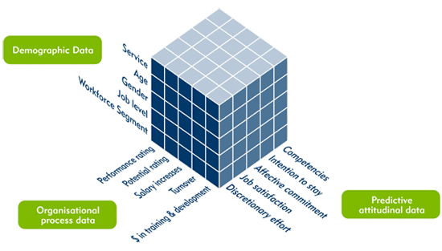
Data Cube Aggregation
The lowest level of a data cube (base cuboid)
  The aggregated data for an individual entity of interest
  E.g., a customer in a phone calling data warehouse
Multiple levels of aggregation in data cubes
  Further reduce the size of data to deal with
Reference appropriate levels
  Use the smallest representation which is enough to solve the task
Queries regarding aggregated information should be answered using data cube, when possible

Slide 79
Automatic Concept Hierarchy Generation
Some hierarchies can be automatically generated based on the analysis of the number of distinct values per attribute in the data set
  The attribute with the most distinct values is placed at the lowest level of the hierarchy
  Exceptions, e.g., weekday, month, quarter, year
country
15 distinct values
province_or_ state
365 distinct values
city
3567 distinct values
street
674,339 distinct values

Slide 80
Sampling
Sampling: obtaining a small sample s to represent the whole data set N
Allow a mining algorithm to run in complexity that is potentially sub-linear to the size of the data
Key principle: Choose a representative subset of the data
  Simple random sampling may have very poor performance in the presence of skew
  Develop adaptive sampling methods, e.g., stratified sampling:
Note: Sampling may not reduce database I/Os (page at a time)

Slide 81
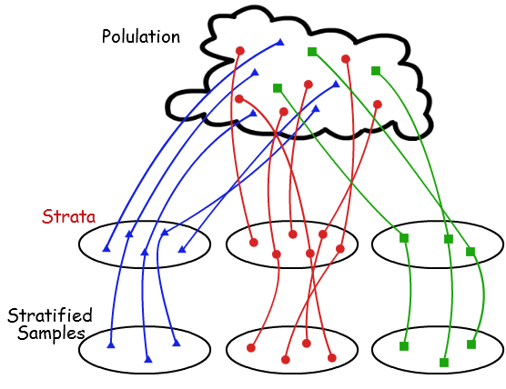
Types of Sampling
Simple random sampling: equal probability of selecting any particular item
Sampling without replacement
  Once an object is selected, it is removed from the population
Sampling with replacement
  A selected object is not removed from the population
Stratified sampling
  Partition (or cluster) the data set, and draw samples from each partition (proportionally, i.e., approximately the same percentage of the data)
Raw Data
SRSWOR
(simple random
sample without
replacement)
SRSWR
Stratified sampling

Slide 82
Data Preprocessing
Data Preprocessing: An Overview
  Data Quality
  Major tasks in Data Preprocessing
Data Cleaning
Data Integration
Data Transformation
Dimensionality Reduction
Summary

Slide 83
Data Reduction Strategies
Data reduction: Obtain a reduced representation of the data set that is much smaller in volume but yet produces the same (or almost the same) analytical results
Why data reduction? — A database/data warehouse may store terabytes of data. Complex data analysis may take a very long time to run on the complete data set.
Data reduction strategies
  Dimensionality reduction, e.g., remove unimportant attributes
    Wavelet transforms
    Principal Components Analysis (PCA)
    Feature subset selection, feature creation
  Numerosity reduction (some simply call it: Data Reduction)
    Regression and Log-Linear Models
    Histograms, clustering, sampling
    Data cube aggregation
  Data compression

Slide 84
Data Reduction 1: Dimensionality Reduction
Curse of dimensionality
  When dimensionality increases, data becomes increasingly sparse
  Density and distance between points, which is critical to clustering, outlier analysis, becomes less meaningful
  The possible combinations of subspaces will grow exponentially
Dimensionality reduction
  Avoid the curse of dimensionality
  Help eliminate irrelevant features and reduce noise
  Reduce time and space required in data mining
  Allow easier visualization
Dimensionality reduction techniques
  Wavelet transforms
  Principal Component Analysis
  Supervised and nonlinear techniques (e.g., feature selection)

Slide 85



Mapping Data to a New Space
Fourier transform
Wavelet transform
Two Sine Waves
Two Sine Waves + Noise
Frequency

Slide 86

What Is Wavelet Transform?
Decomposes a signal into different frequency subbands
  Applicable to n-dimensional signals
Data are transformed to preserve relative distance between objects at different levels of resolution
Allow natural clusters to become more distinguishable
Used for image compression

Slide 87
Wavelet Transformation
Haar2
Daubechie4
Discrete wavelet transform (DWT) for linear signal processing, multi-resolution analysis
Compressed approximation: store only a small fraction of the strongest of the wavelet coefficients
Similar to discrete Fourier transform (DFT), but better lossy compression, localized in space
Method:
  Length, L, must be an integer power of 2 (padding with 0’s, when necessary)
  Each transform has 2 functions: smoothing, difference
  Applies to pairs of data, resulting in two set of data of length L/2
  Applies two functions recursively, until reaches the desired length

Slide 88

Wavelet Decomposition
Wavelets: A math tool for space-efficient hierarchical decomposition of functions
S = [2, 2, 0, 2, 3, 5, 4, 4] can be transformed to S^ = [2³/₄, -1¹/₄, ¹/₂, 0, 0, -1, -1, 0]
Compression: many small detail coefficients can be replaced by 0’s, and only the significant coefficients are retained

Slide 89
Why Wavelet Transform?
Use hat-shape filters
  Emphasize region where points cluster
  Suppress weaker information in their boundaries
Effective removal of outliers
  Insensitive to noise, insensitive to input order
Multi-resolution
  Detect arbitrary shaped clusters at different scales
Efficient
  Complexity O(N)
Only applicable to low dimensional data

Slide 90
Principal Component Analysis (PCA)
Find a projection that captures the largest amount of variation in data
The original data are projected onto a much smaller space, resulting in dimensionality reduction. We find the eigenvectors of the covariance matrix, and these eigenvectors define the new space
x₂
e
x₁

Slide 91
Principal Component Analysis (Steps)
Given N data vectors from n-dimensions, find k ≤ n orthogonal vectors (principal components) that can be best used to represent data
  Normalize input data: Each attribute falls within the same range
  Compute k orthonormal (unit) vectors, i.e., principal components
  Each input data (vector) is a linear combination of the k principal component vectors
  The principal components are sorted in order of decreasing “significance” or strength
  Since the components are sorted, the size of the data can be reduced by eliminating the weak components, i.e., those with low variance (i.e., using the strongest principal components, it is possible to reconstruct a good approximation of the original data)
Works for numeric data only
Reference: https://www.turing.com/kb/guide-to-principal-component-analysis

Slide 92
Attribute Subset Selection
Another way to reduce dimensionality of data
Redundant attributes
  Duplicate much or all of the information contained in one or more other attributes
  E.g., purchase price of a product and the amount of sales tax paid
Irrelevant attributes
  Contain no information that is useful for the data mining task at hand
  E.g., students' ID is often irrelevant to the task of predicting students' GPA

Slide 93
Heuristic Search in Attribute Selection
There are 2^{d} possible attribute combinations of d attributes
Typical heuristic attribute selection methods:
  Best single attribute under the attribute independence assumption: choose by significance tests
  Best step-wise feature selection:
    The best single-attribute is picked first
    Then next best attribute condition to the first, ...
  Step-wise attribute elimination:
    Repeatedly eliminate the worst attribute
  Best combined attribute selection and elimination
  Optimal branch and bound:
    Use attribute elimination and backtracking
  Decision tree induction

Slide 94
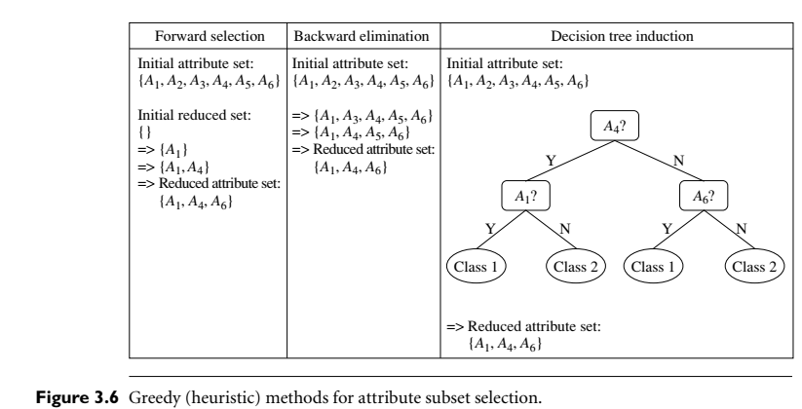

Slide 95
Attribute Creation (Feature Generation)
Create new attributes (features) that can capture the important information in a data set more effectively than the original ones
Three general methodologies
  Attribute extraction
    Domain-specific
  Mapping data to new space (see: data reduction)
    E.g., Fourier transformation, wavelet transformation, manifold approaches (not covered)
  Attribute construction
    Combining features (see: discriminative frequent patterns in Chapter 7)
    Data discretization

Slide 96
Data Reduction 2: Numerosity Reduction
Reduce data volume by choosing alternative, smaller forms of data representation
Parametric methods (e.g., regression)
  Assume the data fits some model, estimate model parameters, store only the parameters, and discard the data (except possible outliers)
  Ex.: Log-linear models—obtain value at a point in m-D space as the product on appropriate marginal subspaces
Non-parametric methods
  Do not assume models
  Major families: histograms, clustering, sampling, …

Slide 97
Numerosity reduction
Regression and Log-Linear Models
Linear regression
  Data modeled to fit a straight line
  Often uses the least-square method to fit the line
Multiple regression
  Allows a response variable Y to be modeled as a linear function of multidimensional feature vector
Log-linear model
  Approximates discrete multidimensional probability distributions

Slide 98
Regression Analysis
y
Y1
Regression analysis: A collective name for techniques for the modeling and analysis of numerical data consisting of values of a dependent variable (also called response variable or measurement) and of one or more independent variables (aka. explanatory variables or predictors)
The parameters are estimated so as to give a "best fit" of the data
Most commonly the best fit is evaluated by using the least squares method, but other criteria have also been used
Y1’
y = x + 1
X1
x
Used for prediction (including forecasting of time-series data), inference, hypothesis testing, and modeling of causal relationships

Slide 99
Regress Analysis and Log-Linear Models
Linear regression: Y = w X + b
  Two regression coefficients, w and b, specify the line and are to be estimated by using the data at hand
  Using the least squares criterion to the known values of Y₁, Y₂, …, X₁, X₂, ….
Multiple regression: Y = b₀ + b₁ X₁ + b₂ X₂
  Many nonlinear functions can be transformed into the above
Log-linear models:
  Approximate discrete multidimensional probability distributions
  Estimate the probability of each point (tuple) in a multi-dimensional space for a set of discretized attributes, based on a smaller subset of dimensional combinations
  Useful for dimensionality reduction and data smoothing

Slide 100
Histogram Analysis
Divide data into buckets and store average (sum) for each bucket
Partitioning rules:
  Equal-width: equal bucket range
  Equal-frequency (or equal-depth)

Slide 101
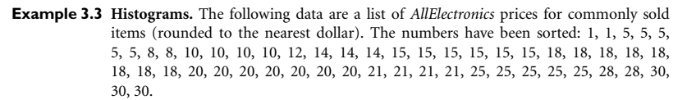
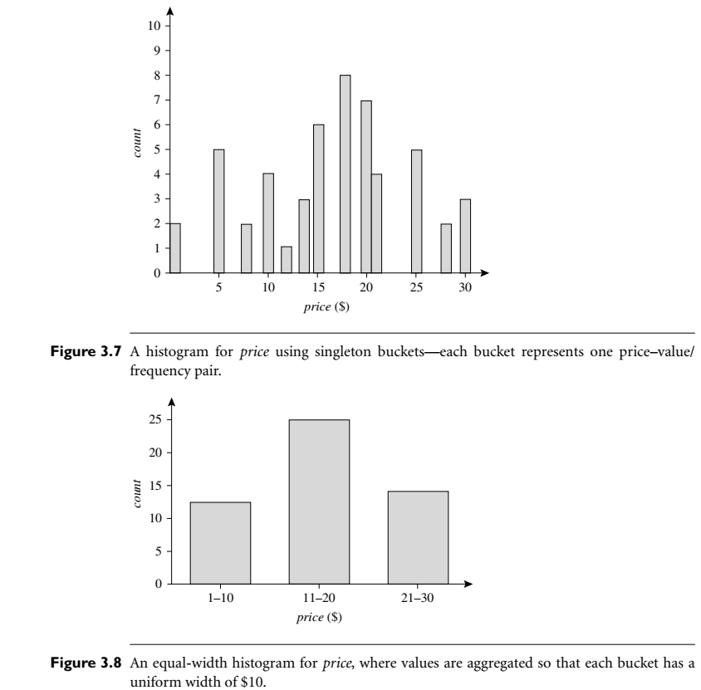

Slide 102
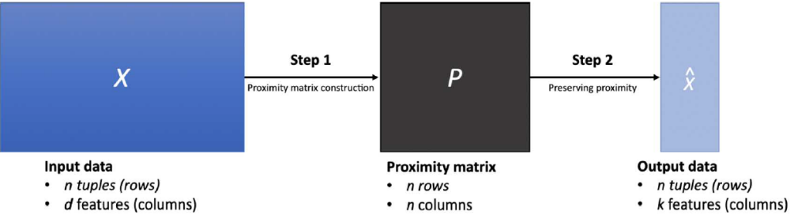
Nonlinear Dimensionality Reduction Methods
PCA is a linear method for dimensionality reduction
  Each principal component is a linear combination of the original input attributes
  It works well if the input data approximately follows a Gaussian distribution or forms a few linearly separable clusters
When the input data is linearly inseparable, we need to construct a proximity matrix (P) and learn a new matrix with k features (k << d) that preserves the proximity

Slide 103
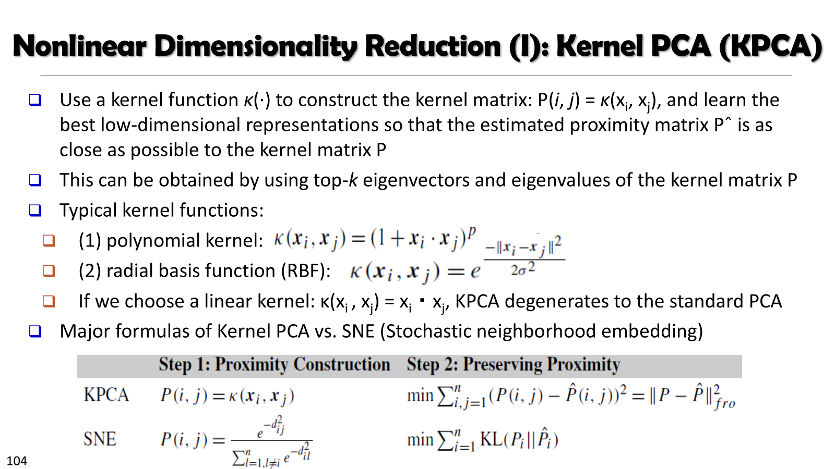

Slide 104
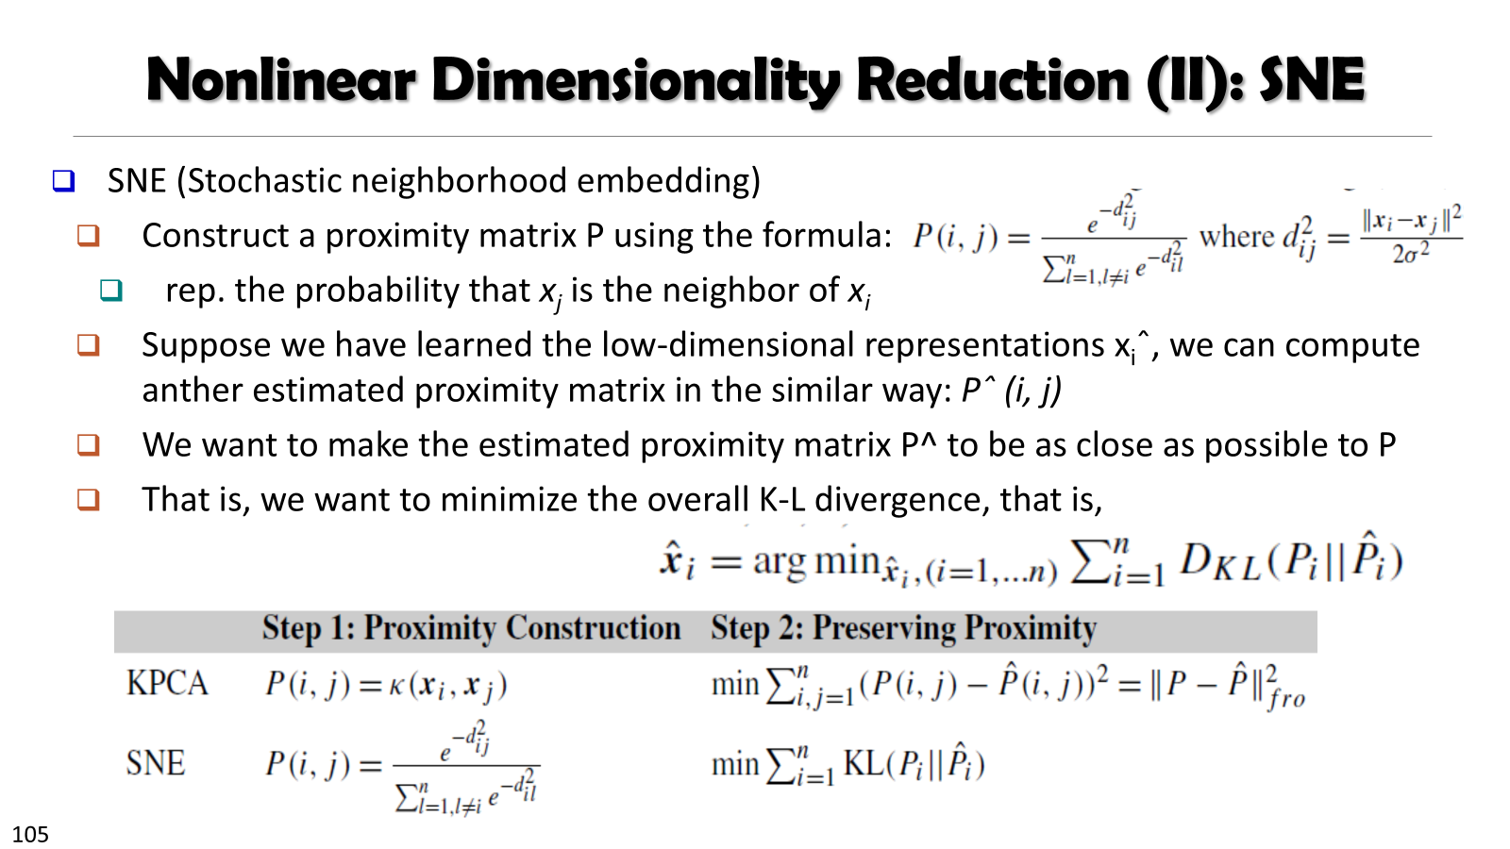

Slide 105
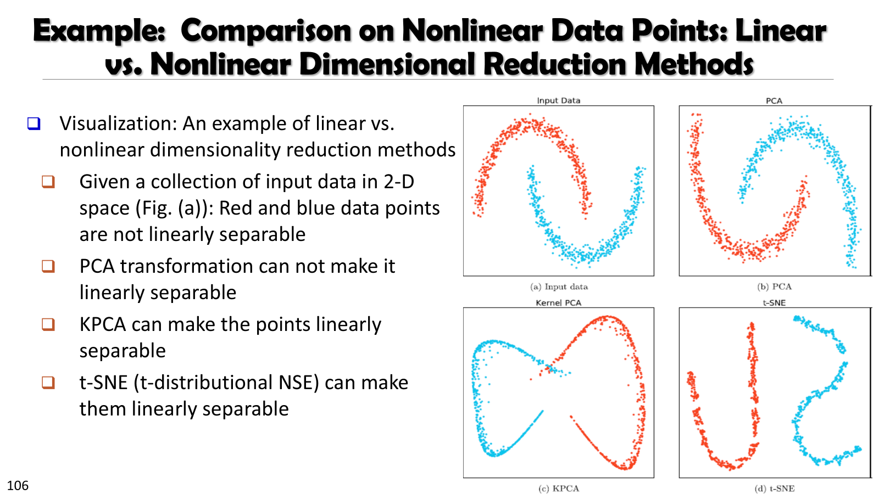

Slide 106
Summary
Data quality: accuracy, completeness, consistency, timeliness, believability, interpretability
Data cleaning: e.g. missing/noisy values, outliers
Data integration from multiple sources:
  Entity identification problem
  Remove redundancies
  Detect inconsistencies
Data reduction
  Dimensionality reduction
  Numerosity reduction
  Data compression
Data transformation and data discretization
  Normalization
  Concept hierarchy generation

Slide 107
References
Refer to the Bibliographic notes of Chapter 2
Book: Jiawei Han, Jian Pei, Hanghang Tong, Data Mining: Concepts and Techniques, Fourth edition, 2022, Elseiver Inc.

